Slide 1

WELCOME TO ENGLISH CLASS

Slide 2


WELCOME TO ENGLISH CLASS
“Never give up. Today is hard, tomorrow will be worse, but the day after tomorrow will be sunshine.”
Jack Ma,

Slide 3


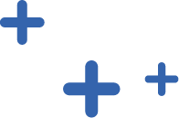
Boolean Algebra and Truth Table
Imagen

Slide 4

DATE
DATE
Objective:
Students will demonstrate their understanding of Boolean Algebra by creating three basic operations

Slide 5

AGENDA
WARM UP:
Game
CLASS ACTIVITY:
Video (“inferring clues from the context” )
Reading Strategy: Rereading
Reading: Boolean Algebra
Wrap- Up
Examples of basic operations

Slide 6

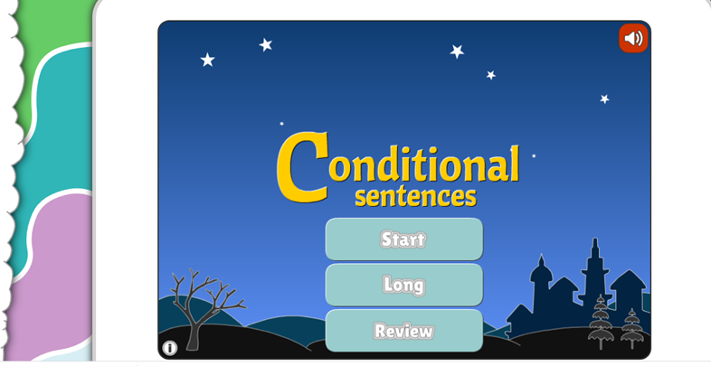

WARM-UP
Play the following game
https://www.gamestolearnenglish.com/conditional-sentences/

Slide 7

Video Reading Strategy
https://www.youtube.com/watch?v=eHCpJ86XDY4

Slide 8

Read the Paragraph
Boolean algebra is a division of mathematics that deals with operations on logical values and incorporates binary variables. Boolean algebra traces its origins to an 1854 book by mathematician George Boole.
The distinguishing factor of Boolean algebra is that it deals only with the study of binary variables. Most commonly Boolean variables are presented with the possible values of 1 ("true") or 0 ("false"). Variables can also have more complex interpretations. Boolean algebra is also known as binary algebra.

Slide 9
Text Boolean Algebra
Boolean Algebra
Boolean Algebra is fundamental to the operation of software and hardware. If you are in IT, then Boolean Algebra is very important for you. Boolean Algebra is a form to formally specify, or describe, a particular situation or procedure. We use variables to represent elements of our situation or procedure. Variables can take one of only two values: True and False. So for example, we have a variable X that represents “if it is raining outside or not”. The value of X is:
True if it is raining outside.
False if it is not raining outside.
It is possible to substitute True and False with other values. When working with computers, True and False is often replaced with 1 and 0.

Slide 10
Text Boolean Algebra
Basic Operations
There are three basic operations. The result of an operation can only be True or False.
1. AND
The first operation is AND. So for example, I can say, "If it's hot outside AND I finished my work, then I will play soccer." To represent this in Boolean Algebra, I can say that:
x represents if it is hot outside or not.
y represents if I finished my work or not.
z represents if I play soccer or not.
Let´s look at the representation of this operation using a Truth table. A truth table is a list of all the possible combinations of inputs and outputs.
x AND y = z

Slide 11
Text Boolean Algebra
2. OR
OR means that if one of the two variables is True then the result is True. So for example, I can say that "I will get home early if I finish work early OR the traffic is good". To represent this in Boolean Algebra, I can say that:
x represents if finish work early.
y represents if the traffic is good.
z represents if I get home early.
x OR y = z

Slide 12
Text Boolean Algebra
Here is the representation in a truth table:
X | Y | Result
False | False | False
True | False | True
False | True | True
True | True | True
Not
Not has the effect of changing the value of a variable to the opposite. For example, I can say: “If I am not full, I will eat a cake.” To represent this in Boolean algebra, I will write:
d represents if I am full
e represents if I eat a cake
the variable d currently has a value of True then
the expression not d has a result of False

Slide 13
Text Boolean Algebra
And as a truth table
X | Result
True | False
False | True

Slide 14

WRAP-UP
Work in groups of three, then give three examples of the three basic operations: one for AND, one for OR, one for NOT.
Think of real-life situations and apply Boolean Algebra – similar to the text.
Use a collaborative tool, such as:
padlet.com
Jamboard (available with your gmail account)
Any other tool that allows students to write on the same webpage at the same time.

Slide 15

SELF-EVALUATION
Fill out the following self-evaluation
Entiendo cómo puedo tratar de entender el significado de las nuevas palabras sin consultar el diccionario. Si ☺ No ☹ Tal vez :|
La estrategia de “inferring” me ayuda a entender el texto que leo mejor. Si ☺ No ☹ Tal vez :|
Pude entender qué es Boolean Algebra. Si ☺ No ☹ Tal vez :|

